Slide 1
Amazon Web Service
Crypto Transfer Chat bot

Slide 2
A cryptocurrency (or crypto currency) is a digital asset designed to work as a medium of exchange that uses cryptography to secure its transactions, to control the creation of additional units, and to verify the transfer of assets. Cryptocurrencies are a type of digital currencies, alternative currencies and virtual currencies. Cryptocurrencies use decentralized control as opposed to centralized electronic money and central banking systems. The decentralized control of each cryptocurrency works through a Blockchain, which is a public transaction database, functioning as a distributed ledger. There are multiple cryptocurrencies available in global market and some the are legal tender in many countries. It is consider as future of banking or financial domain. There are many exchanges which work globally or country specific to buy/sell cryptocurrencies. User might have account in different-different exchanges and it is very common use case that user send/receive cryptocurrencies to different – different accounts.
I have designed a chat bot which can be integrated with any exchange or globally to place send or receive request on cryptocurrency Blockchain. It asks user weather he/she wants to send or receive cryptocurrency. Once user confirms that then it asks sender and receiver email address since it is possible to send cryptocurrencies based on email address as well if users email address is linked with cryptocurrency wallet. After getting sender/receiver address, it asks about amount of cryptocurrency to be transferred, once you enter that then after lambda validations, it places an order for cryptocurrency transaction. But for security reasons, it will notify user that we will send an email to sender to get approval for transaction before placing it in Blockchain. Sending email part is not configured in this solution since it is just a prototype. This prototype works with only BITCOIN, RIPPLE, LITECOIN and ETHEREUM cryptocurrency.
Brief explanation

Slide 3
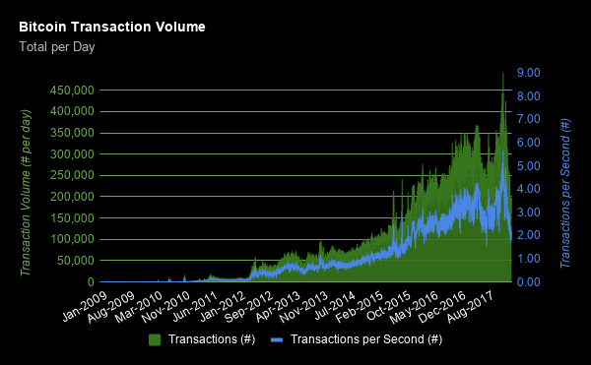
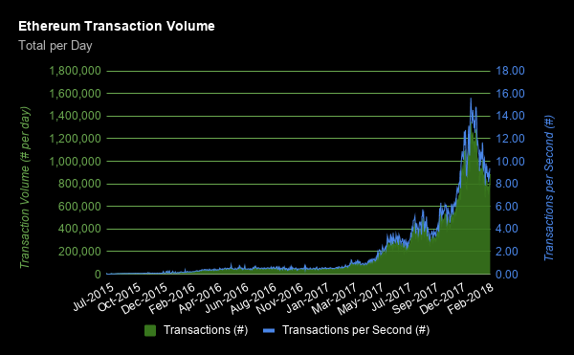
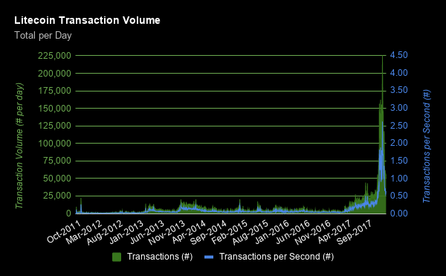
Cryptocurrency market is increasing day by day. Every day Blockchain process millions of transaction per day (please refer below provided screen shots). It is very complex process to send or receive cryptocurrencies. This chat box can be integrated in specific exchange or as a stand alone application (which might required authentication) to make to easy to transfer cryptocurrencies.
Problem being solved using Amazon Lex and AWS Lambda

Slide 4
AWS LEX
AWS LAMBDA
AWS CLOUDWATCH
NODE JS
IAM
Facebook Application
Slack
SES
AWS JavaScript SDK
AWS LEX API
Web Audio API
Amazon LEX Runtime Service
Visual Studio 2013
ASP.NET Web application
Technology/Tool/AWS Stack

Slide 5
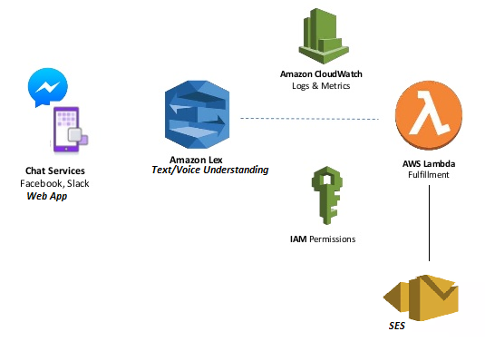
Solution architecture with Amazon Lex and AWS Lambda

Slide 6
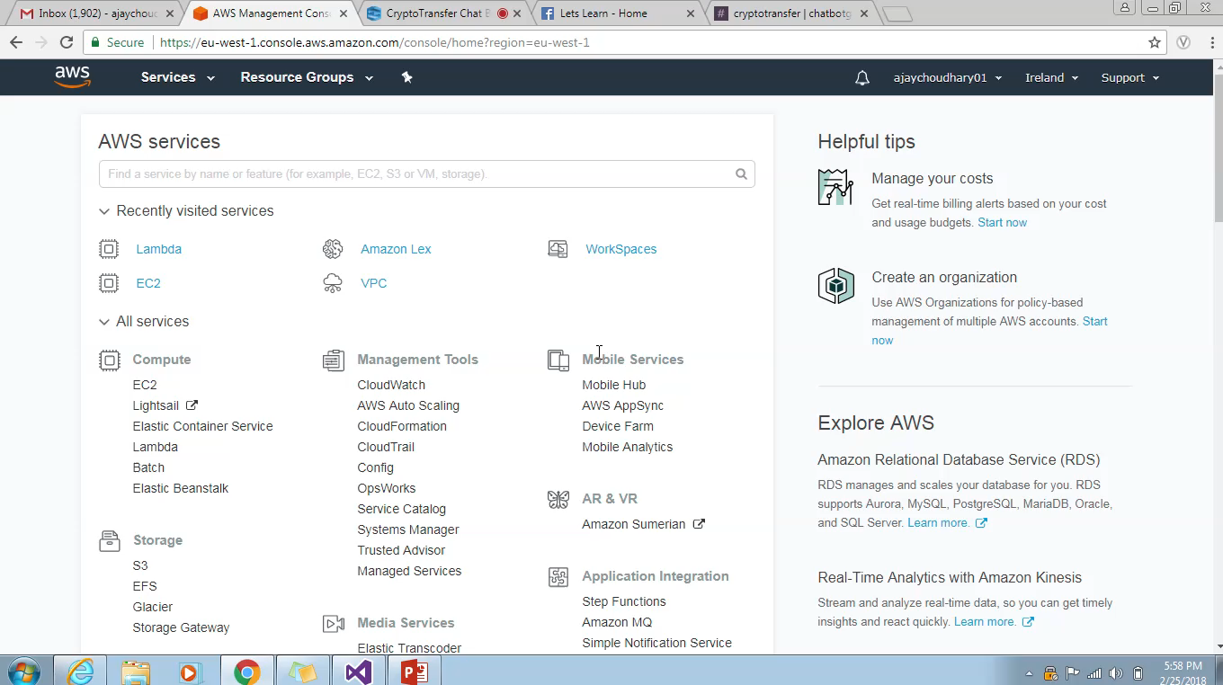
Bot demonstration video

Slide 7
Lambda was throwing exception, when integrated with LEX, issue was resolved with changing permissions in IAM.
Tried to host web app to EC2 but since EC2 machines are virtual machines, they don’t support audio compatibility.
Challenges faced

Slide 8
Possible Improvement
01
AWS Stack Automation
Automation of AWS stack with Cloud formation and AWS SDKs
02
Database Integration
Any NOSQL database like Dynamo DB can be integrated to place request and maintain different utterance and possibilities.

Slide 9


